Slide 1
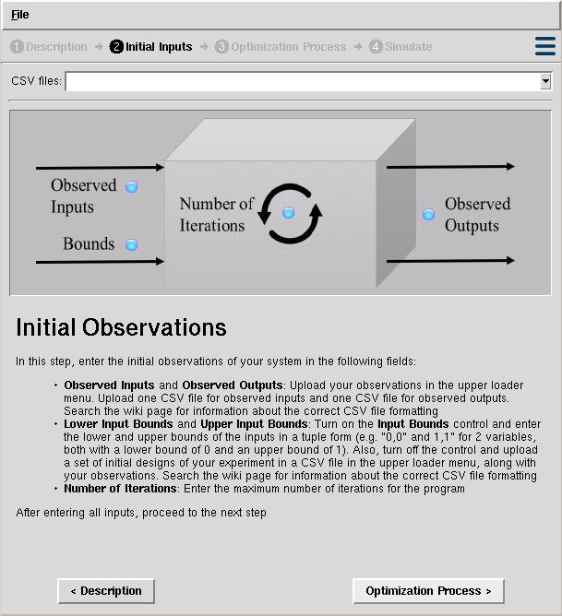
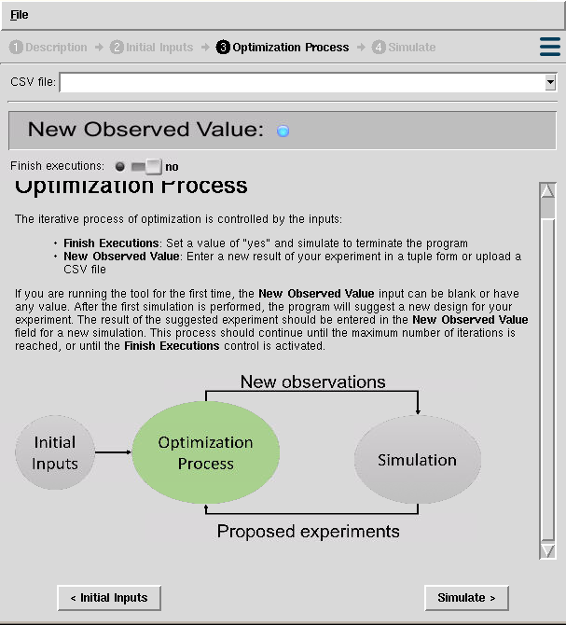
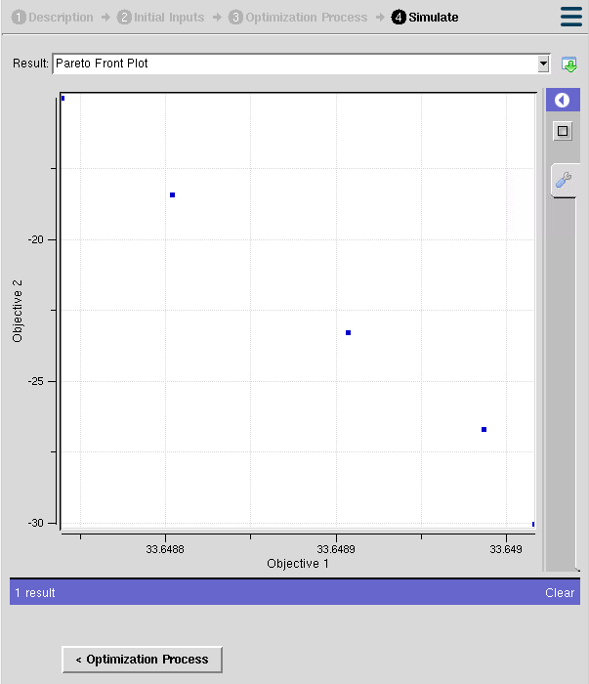
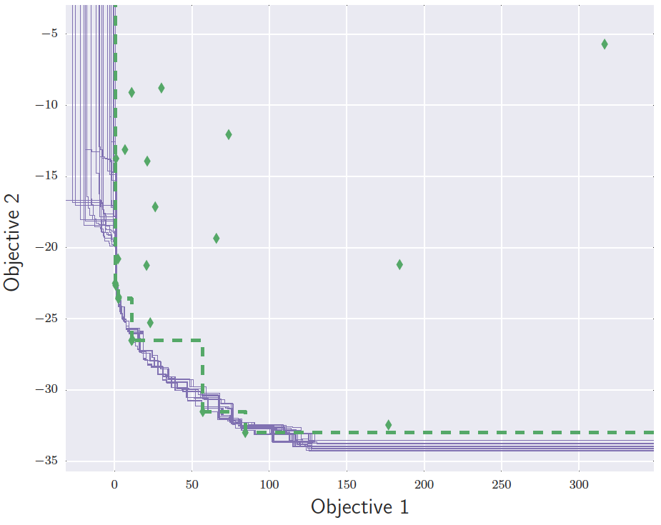
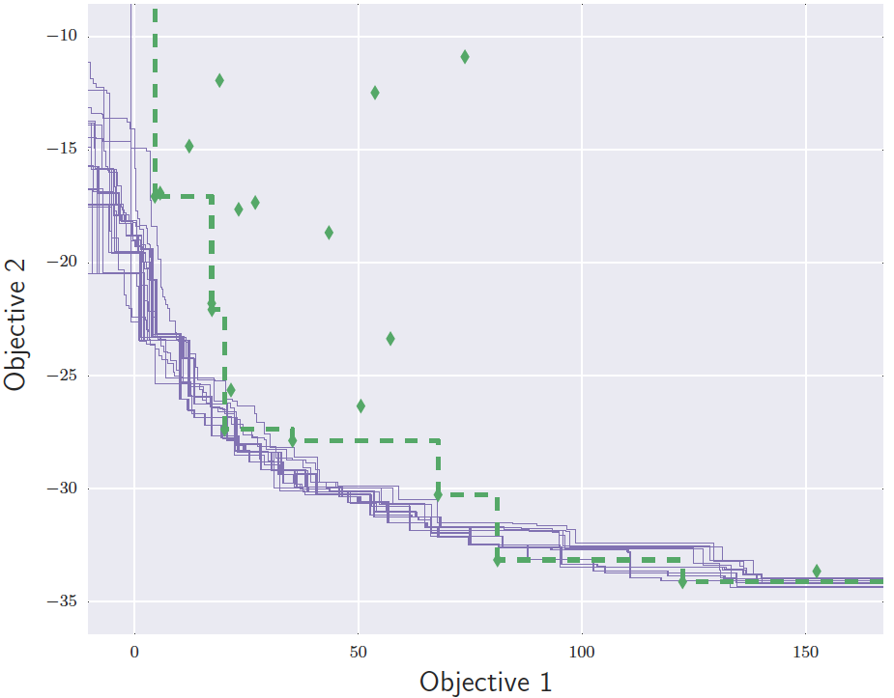
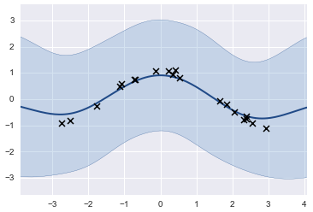
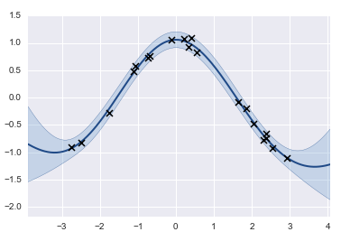

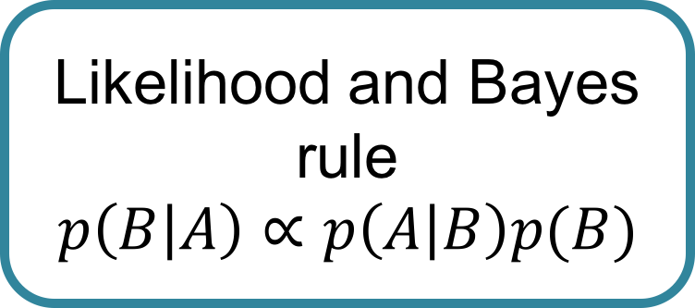
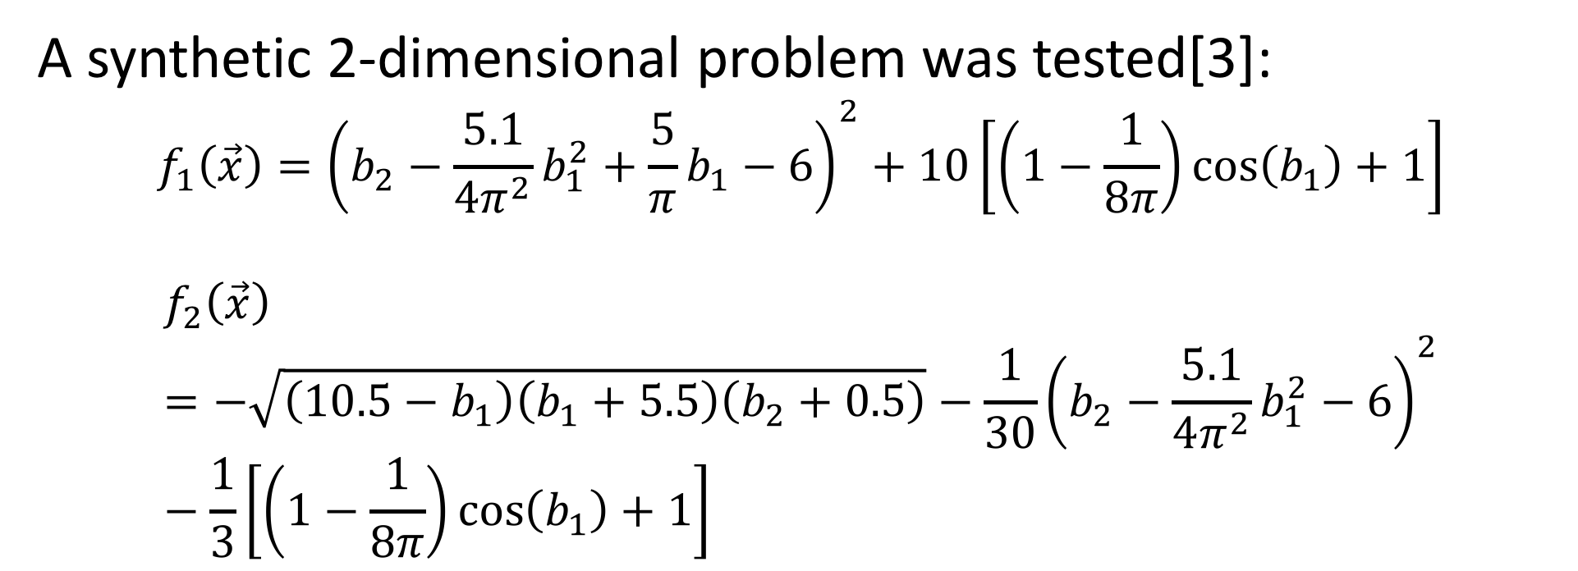
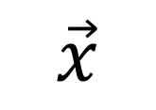
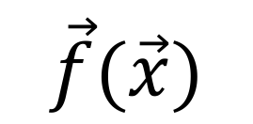
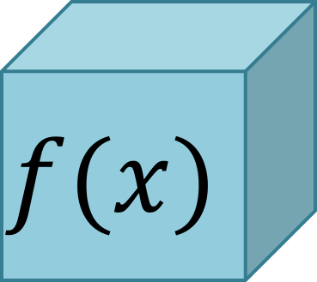
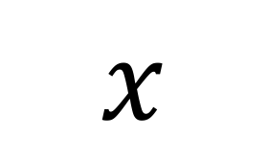
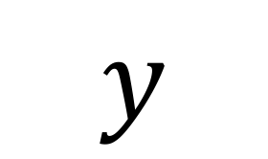
Gaussian Process Regressions for Objective Surrogates in Stochastic Multi-Objective Optimization
Juan Sebatian Martinez*, Piyush Pandita✝, Rohit Tripathy ✝, Ilias Bilionis ✝
*Department of Electric and Electronic Engineering, Universidad de Los Andes, Bogotá D.C, 111711, Colombia.
✝ Department of Mechanical Engineering, Purdue University, West Lafayette, Indiana, IN 47907, USA.
Background and Motivation…
Our Objective…
Our Results…
Optimization defines the situation where a function that describes the operation of a system should be minimized or maximized, restricted to some constraints imposed by the system itself.
The Pareto front defines the set of optimal values for the objectives in the system being analyzed.
Given some observations and an iterative optimization process, the Pareto front is discovered, along with the experimental designs that generated it.
$$x$$
$$f(x)$$
$$y$$
Time
Materials
…
Heat dissipation
Cost
…
SMOOT (Stochastic Multi-Objective Optimization Tool):
https://nanohub.org/tools/smoot/
Pareto Front
A synthetic 2-dimensional problem was tested[3]:
$$f_{1}\left(\vec{x}\right)={\left(b_{2}−\frac{5.1}{4π^{2}}b_{1}^{2}+\frac{5}{π}b_{1}−6\right)}^{2}+10\left[\left(1−\frac{1}{8π}\right)\cos\left(b_{1}\right)+1\right]$$
$$f_{2}\left(\vec{x}\right)=−\sqrt{\left(10.5−b_{1}\right)\left(b_{1}+5.5\right)\left(b_{2}+0.5\right)}−\frac{1}{30}{\left(b_{2}−\frac{5.1}{4π^{2}}b_{1}^{2}−6\right)}^{2}−\frac{1}{3}\left[\left(1−\frac{1}{8π}\right)\cos\left(b_{1}\right)+1\right]$$
$$\min_{x}{f(x)}$$
The optimization problem
The Methods…
The Problem…
Initial observations
Train GP surrogates
Project observations
Compute expected improvement
Real life optimization problems in science and engineering share similar issues:
Multiple objectives
Limited observations
Expensive experiments or evaluations of computer code
Black box systems
Noise in observations
Epistemic uncertainty
Add new observation
Propose a design
General methodology
Gaussian process regressions to build objective surrogates:
At the end…
A Gaussian process (GP) is a collection of random variables, any finite number of which have a joint Gaussian distribution [1]
Prior Information and beliefs
Using Gaussian process regressions is an effective method for building objective surrogates under uncertainty
The method allows experimentalists to obtain an optimal set of designs to apply in their experiments, with no extra costs or inefficient use of resources
?
$$\vec{x}$$
$$\vec{f}(\vec{x})$$
Likelihood and Bayes rule
$$p\left(B | A\right)∝p\left(A | B\right)p(B)$$
Posterior
Black box system
Data Observations
Different approaches have been taken through evolutionary algorithms:
Large amount of observations required
Uncertainty is not considered
References
[1] M. Seeger, Gaussian processes for machine learning. , vol. 14. 2004.
[2] Emmerich, Michael, and Jan-willem Klinkenberg. "The computation of the expected improvement in dominated hypervolume of Pareto front approximations." Rapport technique, Leiden University (2008).
[3] J. Parr, Improvement criteria for constraint handling and multiobjective optimization . PhD
thesis, University of Southampton, 2013.
A Gaussian process regression

